Slide 1
DevOps Deep Dive: Test Data Management
July 29, 2015

Slide 2



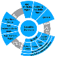












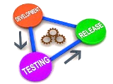


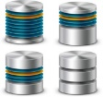


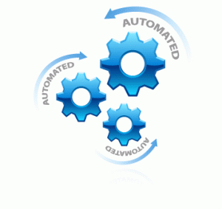















DevOps Value Chain
“Transform technology at Fannie Mae for repeatable and scalable software development services that increase quality, reduce costs, and improve time to market”
AUTOMATED TRACEABILITY
iCart
Code
Requirements
Incidents/ Defects
CODE
QUALITY
CONTINUOUS
INTEGRATION/ DELIVERY
Automated Reporting
RELEASE MANAGEMENT
Discover
Discover
Discover
Design
Develop
Test
Design
Design
Design
Test
Deploy
Test
Test
Monitor /
Operate
Sprint #1
Sprint #2
Sprint #3
Develop
Develop
Develop
Continuous Delivery
ENVIRONMENT
CONFIGURATION
TEST DATA DELIVERY
SERVICE VIRTUALIZATION
TEST AUTOMATION
AUTOMATED DATA VALIDATION
TEST PERFORMANCE
90% labor reduction for testing
of large unit, component,
integration, progression and
regression suites
Early identification, tracking and
remediation of code defects
Significantly faster provisioning of
development & test environments
VM
Data Generator
SeleniumHQ
Data Testing
Framework

Slide 3

Let’s Face it…
Test Data Management is HARD
Generating Prod-like synthetic data
Finding and subsetting just the right Prod data
Referential integrity across systems for E2E Testing
Storing, aging, and versioning the data
Generating XML (or other) interface files
Distributing and sharing data across mutiple environments
Manipulating test databases to mimic the future state
Resetting test data to run it all again

Slide 4




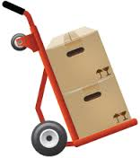

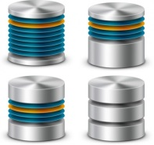






Test Data Management Target Operating Model
Current model
Customized data subsets
Customized msg generation
Manual data distribution
Target model
Standardized data subsets
Pre-defined msg generation
Automated data distribution
Self – Service
Model

Slide 5
TEST DATA DELIVERY
In-house, custom tool to generate large volumes of synthetic data quickly and repeatedly.
Data Generator
Added module to our Informatica suite that speeds data model discovery and greatly reduces subsetting times.
Data Generator
Virtual data storage and delivery tool that enables a broad range of self-service capabilities with test data.

Slide 6
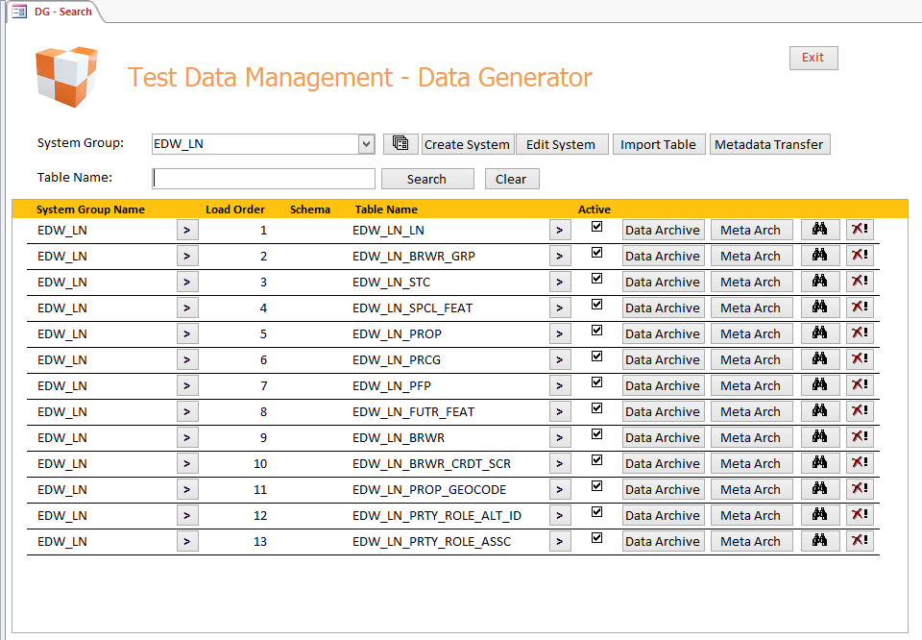
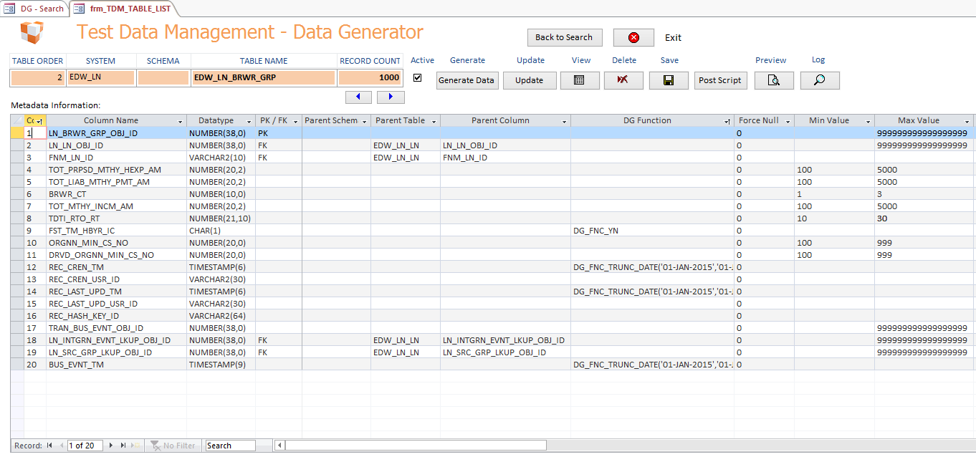

Data Generator
Robust, Flexible Synthetic Data Generation
Data or flat files with user-specified boundaries
Relational data through foreign key relationship
Large volumes of data return in minutes
Table metadata edit capabilities
Archive and restore data and metadata
Duplicate data
Export data to files
Truncate and delete table data
Load Meta Data into Data Generator

Slide 7
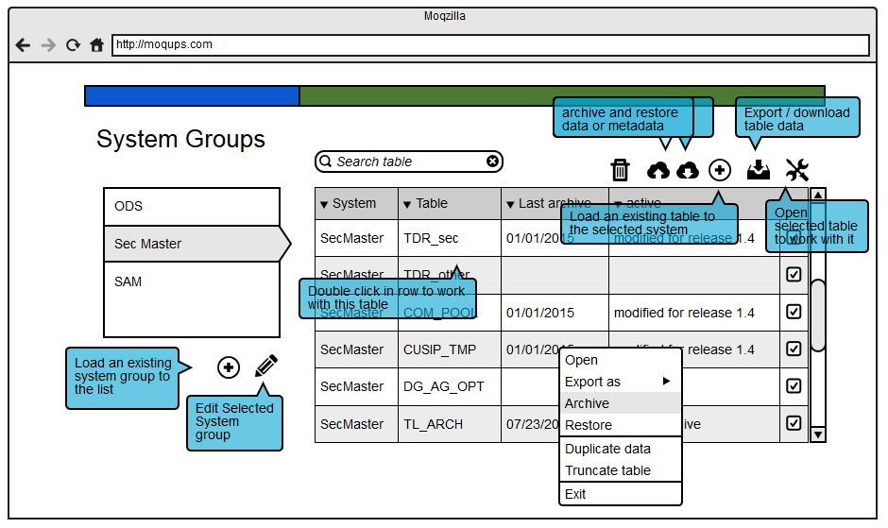
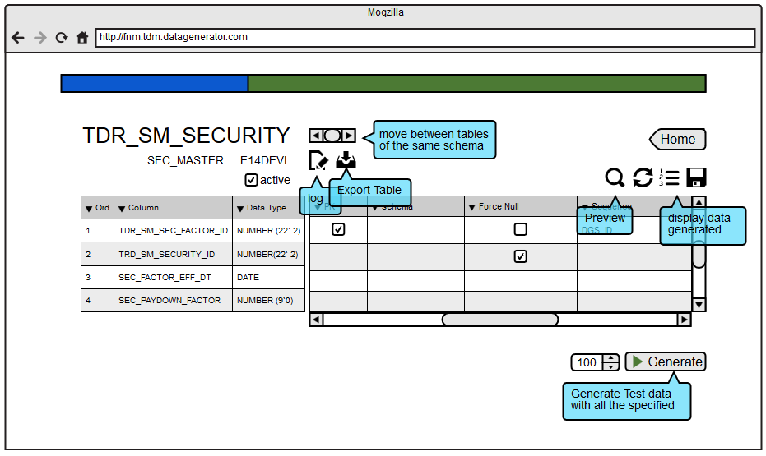
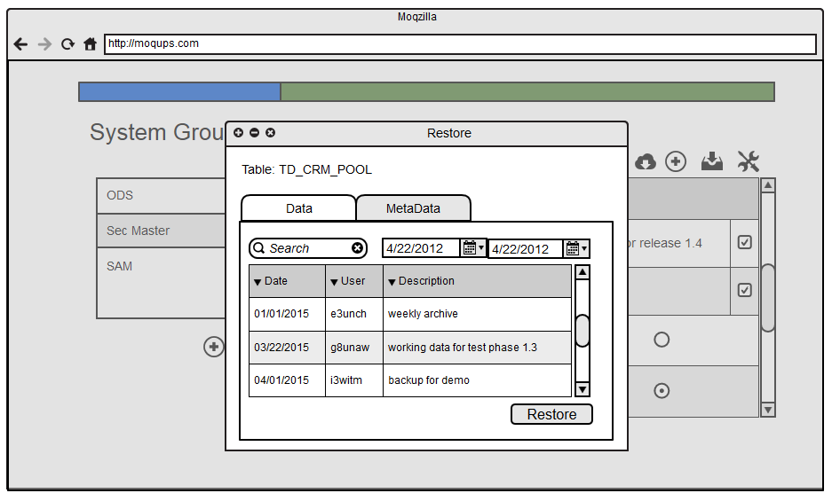
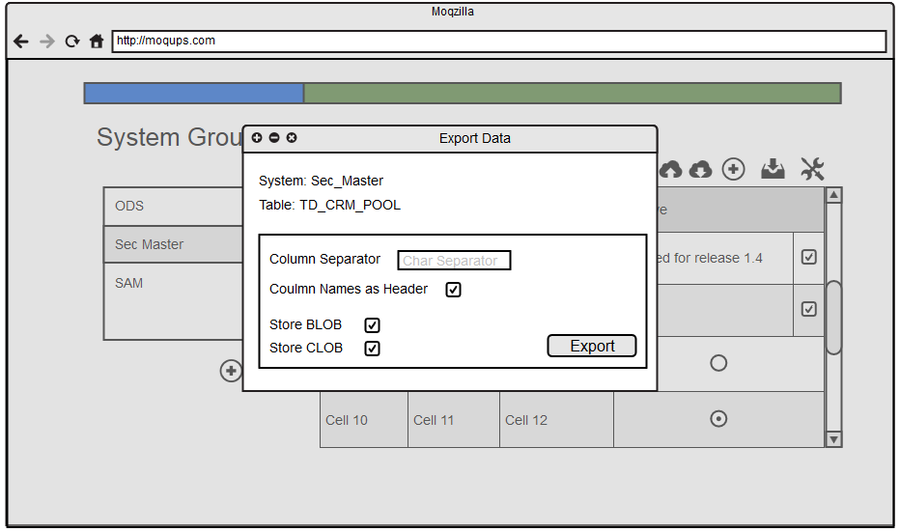
Release1
Release 2
Release 3
Data Generator Timeline
August (Internal Release)
New web Interface
Manage Projects (System Goups)
Create/Update data based on user-specified metadata
Generated data review
November (Available for Use)
Enhanced security using SSO
Metadata validation
Create and alter tables through the user interface
Exported data download
Reference data upload (lookups)
December
Fixed length file export
Data duplication (simplified logic)
Data archive retention enforcement
Log retention enforcement
Prescript and postscript creation and execution

Slide 8

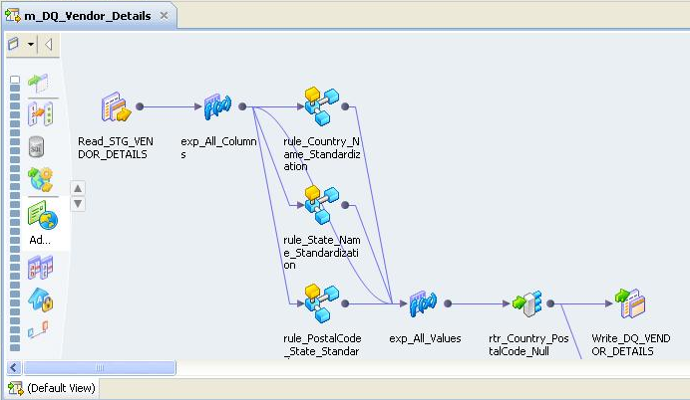
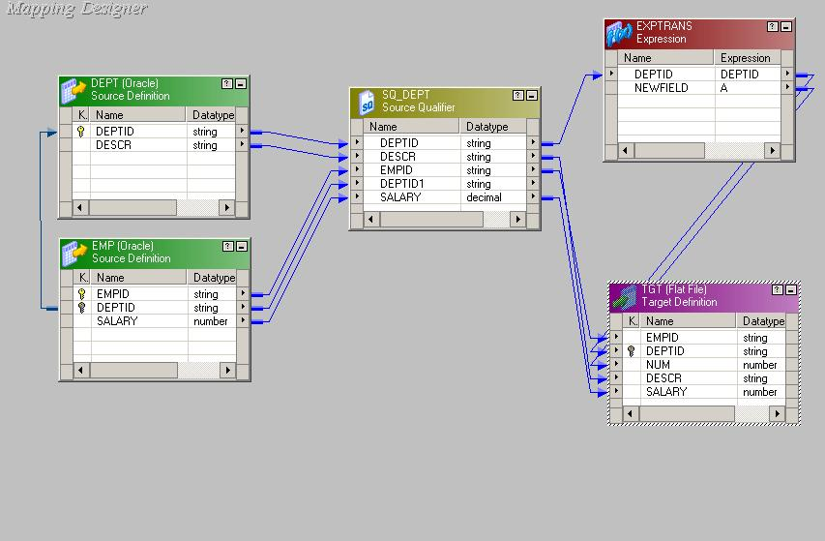
Data Subsetting
Automated “Right Sizing” of Test Data
Scalable subsets from heterogeneous applications
Precise, referentially intact data subsets
Intelligently maintains data relationships
Support for Oracle, Sybase, SQL, DB2, VSAM, etc.
Build and reuse data subset templates quickly
Subset policies function despite application changes
Export data to files
Truncate and delete table data

Slide 9
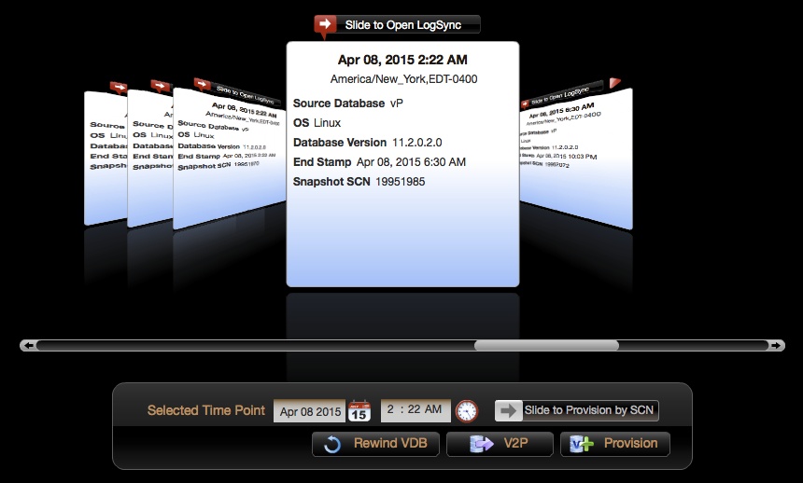
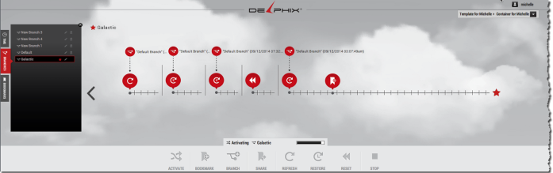
Test Data Control Center
Test Data Delivery made EASY (well, easier)
Cut storage footprint in half (at least)
Deliver full production copies in minutes
Connect to multiple data sets in one environment
‘Time Machine’ ability to wind data back in time
Reset test data in minutes
Branch off multiple copies
Share data and results between environments

Slide 10
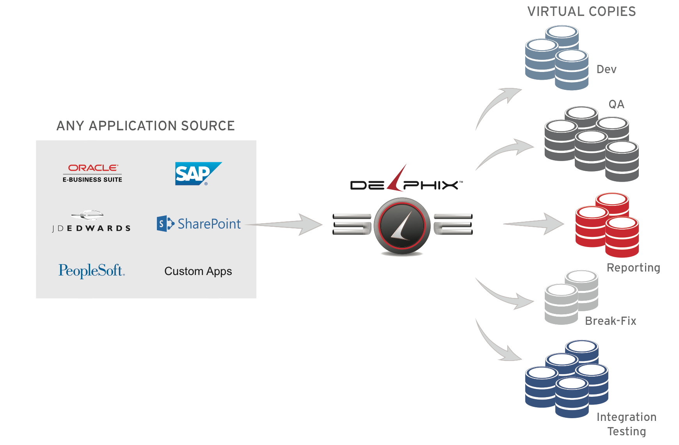

Test Data Control Center
Data as a Service

Slide 11
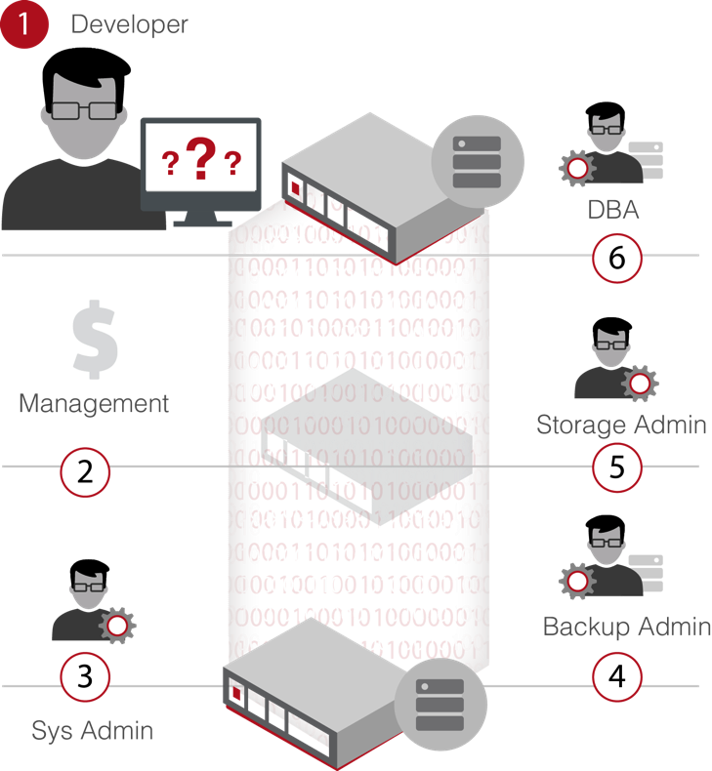



Test Data Control Center
Production Environment
Non-Production Environment
Test-Data
Request
Development
Test
Data
1TB
1. Open Ticket
2. Subset Data
3. Fabricate Data
4. Sys Admin
4. Storage Admin
5. DBA
7. Deliver Data
Takes Days/Weeks
Test
Data
1TB
Testing
Data Sources
Quality Assurance
Test
Data
1TB
DB Binaries, Files
Storage
1TB
Database
Test
Data
1TB
Integration
BI or
DWH
Test
Data
1TB
Backup
and DR
Test
Data
1TB

Slide 12



Test Data Control Center
Production Environment
Non-Production Environment
Test-Data
Request
Development
Under 5 min.
Testing
Data Sources
Quality Assurance
DB Binaries, Files
Database
Integration
1TB
Storage
BI or
DWH
1TB
Storage
Backup
and DR

Slide 13


Test Data Control Center
Production Environment
Non-Production Environment
Test-Data
Request
Development
Testing
Data Sources
Self-Service for Data Users
Refresh
-
Rewind
-
Branch
-
Share
Data to Users In Minutes
-
Requires up to 90% Less Storage
-
Users Control Their Own Data
Quality Assurance
DB Binaries, Files
Database
Integration
1TB
Storage
Operational Data Store
1TB
Storage
Operational Reporting

Slide 14

Engagement Model
Questions:
Jason Anders
Director, Test Data Management
Director Service Delivery, Securitization
jason_anders@fanniemae.com
Jeff Nogosek (contractor)
Technical Lead, RAMP Test Data Mgt
jeffery_nogosek@fanniemae.com

Slide 15

Questions?

